Slide 1
Chemistry Summer School
5th – 9th August 2019

Slide 2
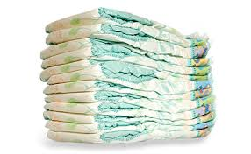
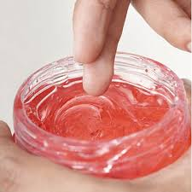
What?
Week long summer school
Learn the chemistry of every day products
Design your very own cream
Take part in CSI Coleraine
(chemical structure identification)
Find out more about the furry thing….

Slide 3
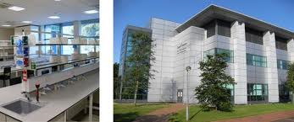
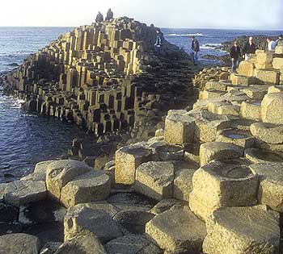
Where?
School of Pharmacy and Pharmaceutical Sciences.
The very happy
Saad building…. ☺
Ulster University, Coleraine Campus

Slide 4
When?
5th – 9th August 2019
Time | 10 am | 11 am | 12 noon | 1 pm | 2 pm | 3 pm
Monday | Welcome and introductions | Lecture 1: Bonding | lunch | Practical: Modern day living in the 21st century – the chemistry of hair gel, nappies and chocolate
Tuesday | Practical: Drawing chemical structures: Symyx Draw |  | Athena Swan: Inspirational women in Science Conference lunch |  | Lecture 2: functional groups | Lecture 3: chemical reactions
Wednesday | Workshop: bonding and chemical reactions |  | Lunch | Practical: CSI – Coleraine AKA Chemical Structure Identification.
Thursday | Lecture 4: The mole & balancing equations | Lecture 5: The chemistry of medicine | Lunch | Practical: Preparation of personalised aqueous cream
Friday | Workshop: Presentation preparation |  | Working Lunch | Symposium and closing remarks

Slide 5
Why?
Make new friends
Brush up on chemistry skills
Meet UU staff
Have fun
Complete a 5 credit University level module *
win prizes
Be a University student for a week
Check out the Ulster University Coleraine campus
Learn new skills
use cutting edge tools
Achieve a better grade
*Can be used to enhance entry into the School of Pharmacy and Pharmaceutical Sciences

Slide 6
Not all Chemists wear white coats…..
The possibilities are endless

Slide 7
Whoa…
Best of all, it is fully sponsored by the Garfield Weston Trust and..
…. is completely free
……and all lunches provided (just need to arrange own transport)
So hurry – limited places available
To apply fill in the application form and return to:
b.callan@ulster.ac.uk

